Slide 1

Phishing Detector
Workflow
A step-by-step masterclass on building an automated security agent using n8n, Google Sheets, and LLMs.

Slide 2

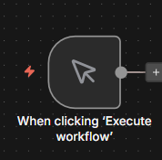
The Starting Point
Manual Trigger Node
Action: Click the + icon and add the "On clicking 'Execute'" node.
Theory & Use Case
This node is your development switch. Unlike a webhook that waits for external events, this allows you to trigger the workflow manually. It's essential for testing small changes safely before deploying the agent to "listen" for real emails.

Slide 3

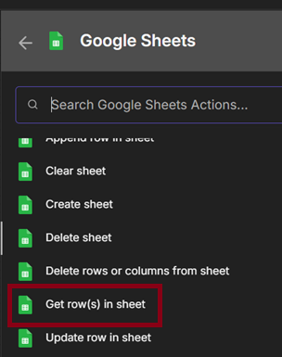
Ingesting Data
Google Sheets Node
Action: Add a Google Sheets node, select Get Many Rows, and connect your "Phishing Data Sheet".
Theory & Use Case
We need a dataset to train or test our agent. This node acts as the pipeline, pulling in raw email content from your spreadsheet. This data typically serves as the queue of suspicious items waiting for analysis.

Slide 4

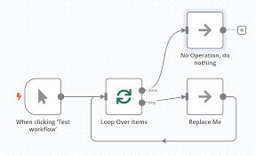
Processing Logic
Loop Over Items
Action: Connect the Loop Over Items node to the Google Sheets output.
Theory & Use Case
Google Sheets returns a bulk "Array" of data. An AI agent is like a human; it reads one email at a time. The Loop node iterates through your data row-by-row, ensuring each email is analyzed individually rather than handling the entire batch at once.

Slide 5

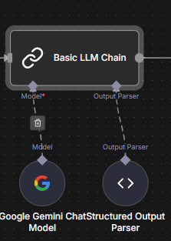
The AI Brain
LLM Chain Node
Action: Set up a Basic LLM Chain. Connect a Model (e.g., OpenAI) and an Output Parser.
Theory & Use Case
This is the core intelligence. We pass the email body from the loop into this node. The Prompt instructs the AI: "You are a security expert. Analyze this email for phishing indicators." The parser ensures the AI returns a structured "Safe" or "Phishing" label.

Slide 6

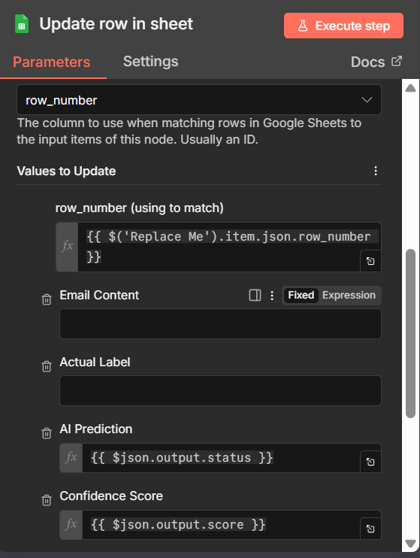
Closing the Loop
Update Sheet Row
Action: Add another Google Sheets node, select Update Row, and map the AI's answer back to the sheet.
Theory & Use Case
Automation isn't complete without action. Here, we write the AI's verdict (Safe/Phishing) back to the original spreadsheet row. This creates a fully automated report without any human data entry.

Slide 7





Workflow Overview
Trigger
Ingest
Loop
Analyze
Save
Manual Start
Get Data
Iterate Rows
LLM Chain
Update Sheet

